Slide 1
Counting
Part 1 – Product Rule and Sum Rule

Slide 2
Basic Counting Principles
Product rule
Sum rule

Slide 3
THE PRODUCT RULE

Slide 4
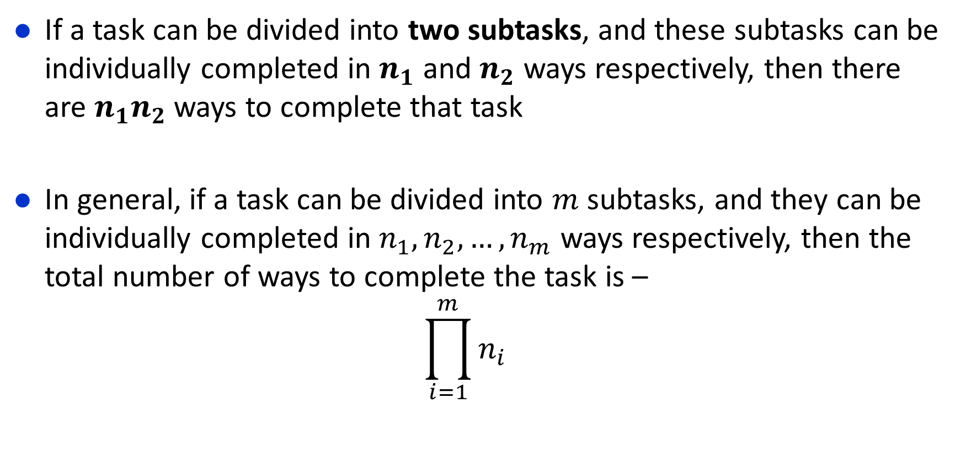
Product Rule

Slide 5
Product Rule
Birthday Treat
Suppose, you want to give birthday treat to your friends in a restaurant. The restaurant offers 3 main course (say, Biryani, Pizza, Pasta) and 2 types of cold drinks (Pepsi, 7Up). Your friend can choose one main course and one cold drink from the given options. How many different choices does your friend have to select the meal ?

Slide 6
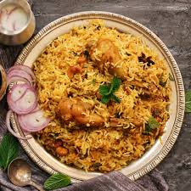
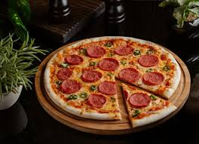
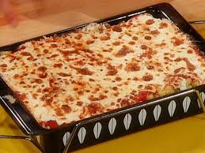
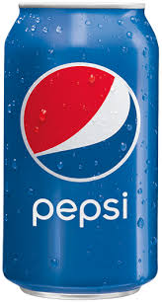

Product Tule
You have to select two items from the menu.
One from the main course, for that you have total three choices.
Another one from the cold drinks, for that you have two options.

Slide 7

Product Rule
If you choose Biryani, then you can take pepsi or 7up with it. Therefore, you have two different choices

Slide 8
Product Rule
If you choose Pizza, then you can take pepsi or 7up with it. Therefore, you have two choices.

Slide 9
Product Rule
If you choose Pasta, then you can take pepsi or 7up with it. Therefore, you have two choices.

Slide 10
Product Rule
Step one: Identify the subtasks
The subtasks SHOULD be done ONE AFTER THE OTHER to make the whole task possible.
The subtasks are connected using AND relationship
In previous example the task GIVING TREAT consisted of two subtasks
SELECTING A MAIN COURSE
SELECTING A DRINK
Step two: Count the possible ways for each subtask
SELECTING A MAIN COURSE – 3 ways
SELECTING A DRINK – 2 ways
Step three : Multiply the possible ways of the subtasks
This gives the possible ways the task can be done
In 3 × 2 = 6 ways you can treat your friends

Slide 11
Product Rule
Another Example: (The first subtask reducing the options for the second subtask)
There are twelve empty rooms in the office of Enosis Solutions. Mamun and Moon joins the company. How many ways can they be assigned a room each from these twelve?
Let us follow the steps again

Slide 12
Product Rule
Total choice for Mamun= 12

Slide 13
Product Rule
Mamun
Total choice for Moon= 11

Slide 14
Product Rule
Total choice for Moon= 11
Mamun

Slide 15
Product Rule
Total choice for Moon= 11
Mamun

Slide 16
Product Rule
For every possible room assignment for Mamun,
there are 11 choices for Moon
Total no. of assignments = 12x11 = 132
Mamun

Slide 17
Product Rule
More Examples:
What is the total number of possible bit strings of length 7?
How many different license plates are available if each plate contains a sequence of three lowercase letters followed by three digits?

Slide 18
THE SUM RULE

Slide 19
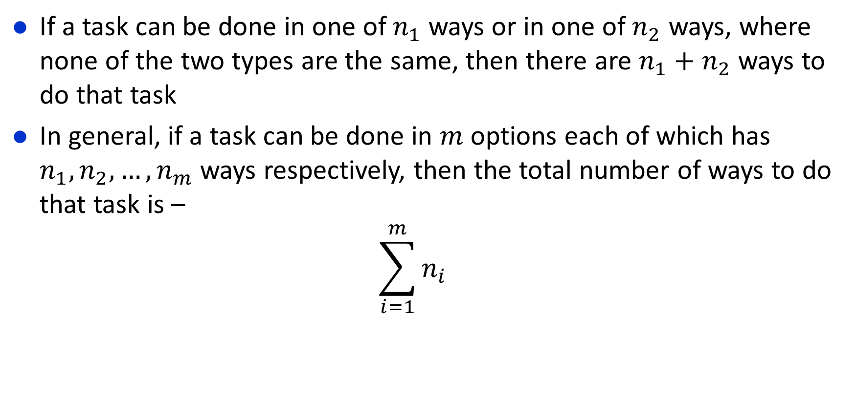
The Sum Rule

Slide 20
The Sum Rule
We can travel from Dhaka to Chattogram in bus, train or by air
How many buses are there?
Shohag, Green line, Hanif
How many trains are there?
Mahanagar, Subarna, Sonar Bangla, Turna
How many flights are there?
Novoair, US-Bangla
So how many ways we can travel?

Slide 21

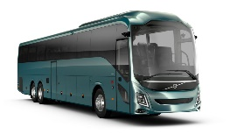

The Sum Rule
The task is TRAVEL FROM DHAKA TO CHITTAGONG
Question : How many ways can the task be done
The different ways of doing this task are:
Novo Air
US Bangla
Shohag
Green Line
Hanif
Dhaka
Ctg
Mahanagar
Subarna
Sonar Bangla
Turna

Slide 22
The Sum Rule
The task is TRAVEL FROM DHAKA TO CHITTAGONG
Question : How many ways can the task be done
The different ways of doing this task are:
2+3+4=9 ways
Novo Air
US Bangla
Shohag
Green Line
Hanif
Dhaka
Ctg
Mahanagar
Subarna
Sonar Bangla
Turna

Slide 23
Sum Rule
Step one: Identify the different options of doing the SAME task
The different options are going to be connected with an OR relationship
Step two: Count the possible ways for each options
Step three: Add the possible ways

Slide 24
The Sum Rule
Another Example
Suppose that either a member of the mathematics faculty or a student who is a mathematics major is chosen as a representative to a university committee. How many different choices are there for this representative if there are 37 members of the mathematics faculty and 83 mathematics majors and no one is both a faculty member and a student?

Slide 25
COMPLEX COUNTING PROBLEMS
Combining the Sum Rule and The Product Rule

Slide 26
Complex Counting problems
Example 15
You are being admitted to a new class, you were asked by your teacher to select an ID of one or two characters.
The ID can contain uppercase alphabets and numbers.
Moreover, a ID must begin with an alphabet and must be different from the five ids of length two that have been taken by 5 other students . (Suppose A1, BB, C1,D2, EF)
In how many ways can you select your ID?

Slide 27
Complex Counting problems
Example 16
Each user on a computer system has a password, which is six to eight characters long
Each character of a password is an uppercase letter or a digit.
Each password must contain at least one digit.
How many possible passwords are there?

Slide 28
SOME PROBLEMS FROM THE EXERCISE

Slide 29
Some Problems From the Exercise
3. A multiple-choice test contains 10 questions. There are four possible answers for each question.
a) In how many ways can a student answer the questions on the test if the student answers every question?
b) In how many ways can a student answer the questions on the test if the student can leave answers blank?
4. A particular brand of shirt comes in 12 colors, has a male version and a female version, and comes in three sizes for each gender. How many different types of this shirt are made?

Slide 30
Some Problems From the Exercise
5. Six different airlines fly from New York to Denver and seven fly from Denver to San Francisco. How many different pairs of airlines can you choose on which to book a trip from New York to San Francisco via Denver, when you pick an airline for the flight to Denver and an airline for the continuation flight to San Francisco?
6. There are four major auto routes from Boston to Detroit and six from Detroit to Los Angeles. How many major auto routes are there from Boston to Los Angeles via Detroit?

Slide 31
Some Problems From the Exercise
8. How many different three-letter initials with none of the letters repeated can people have?
9. How many three-letter initials are there that begin with an A
11. How many bit strings of length ten both begin and end with a 1?
15. How many strings are there of lowercase letters of length four or less, not counting the empty string?
16. How many strings are there of four lowercase letters that have the letter x in them?

Slide 32
Some Problems From the Exercise
17. How many strings of five ASCII characters contain the character @ (“at” sign) at least once? [Note: There are 128 different ASCII characters.]
19. How many 6-element RNA sequences
a) do not contain U?
b) end with GU?
c) start with C?
d) contain only A or U?

Slide 33
Some Problems From the Exercise
33. How many strings of eight English letters are there
a) that contain no vowels, if letters can be repeated?
b) that contain no vowels, if letters cannot be repeated?
c) that start with a vowel, if letters can be repeated?
d) that start with a vowel, if letters cannot be repeated?
e) that contain at least one vowel, if letters can be repeated?
f ) that contain exactly one vowel, if letters can be repeated?
g) that start with X and contain at least one vowel, if letters can be repeated?
h) that start and end with X and contain at least one vowel, if letters can be repeated?

Slide 34
Thank You

